Slide 1
Linear & Binary Search
Course Code: CSC 2211
Course Title: Algorithms
Dept. of Computer Science
Faculty of Science and Technology
Lecturer No: | 5 | Week No: | 5 | Semester: | Summer 22-23
Lecturer: | Pritam Khan Boni; pritam.khan@aiub.edu

Slide 2
Lecture Outline
Searching
  Linear Search
  Binary Search

Slide 3
Searching
Introduction
Search: locate an item in a list of data/information.
Two approaches will be discussed…
Linear or Sequential Search:
  Searches sequentially for an element.
  Starts from the first element.
Binary Search:
  Searches an element by dividing the sorted elements in a list into two sub-list
  Starts with the middle element.

Slide 4
Linear Search
Algorithm and Simulation
Algorithm:
Input: Array, #elements, item (to search)
Start with the element at index = 0
Step 1: Compare the element at index with item. If its equal to item then return index with status “Found” otherwise go to step 2.
Step 2: Increase index by 1. If index is less than #elements go to step 1 otherwise return -1 with status “Not found”.
index
index
index
index
index
index
value
11
false
found
true
0 | 1 | 2 | 3 | 4 | 5 | 6 | 7 | 8 | 9
33 | 66 | 22 | 111 | 77 | 11 | 99 | 55 | 88 | 44
position
5
-1

Slide 5
Linear Search Algorithm
int SearchItem(int arr[], int n, int x)
{
for (int i = 0; i < n; i++)
{
if (arr[i] == x)
{
return i;
}
}
return -1;
}

Slide 6
Linear Search Complexity
Linear Search | Complexity
for (int i = 0; i < n; i++) { | n
if (arr[i] == x) { return i; } } | c1
 | Extra: c2
So, T(n) = O(1) when n = 1, and
n*c1+ c2 when n > 1
skipping the unnecessary terms
T(n)= O(n)

Slide 7
Binary Search
Pseudocode
Process:
Start with f_index = 0 and l_index = size-1
The value of m_index will be (f_index+l_index)/2.
Compare the value of item with arr[m_index].
  If item < arr[m_index], l_index will be m_index-1.
  Else if item > arr[m_index], f_index will be m_index+1.
  Else, position will be m_index. Exit.
Repeat (2), (3) till f_index<= l_index.

Slide 8
Binary Search
Binary Search Algorithm
int m_index, position=-1, f_index=0,l_index=size-1;;
while(f_index<=l_index){
m_index=(f_index+l_index/)2;
if(item<arr[m_index]){
l_index=m_index-1;
}
else if(item>arr[m_index]){
f_index=m_index+1;
}
else{
position=m_index;
}
}

Slide 9
Binary Search
Simulation
last
last
last
60
value
77
first
first
first
first
0
5
5
6
5
last
9
11
22
33
44
55
66
77
88
91
99
9
6
6
4
7
5
middle
6
4
0
1
2
3
4
5
6
7
8
9
middle
middle
middle
middle
found
not found

Slide 10
Binary Search Complexity
Binary Search Algorithm | Complexity
bSearch(arr, x, low, high) | T(n), to sort n elements
if low > high return False else mid = (low + high) / 2 | c1
if x == arr[mid] return mid | T(1)
else if x > arr[mid] return bSearch(arr, x, mid + 1, high) | T(n/2)
else return bSearch(arr, x, low, mid - 1) | T(n/2)
So, T(n) = O(1) when n = 1, and T(n/2) + T(1) + c1 when n > 1

Slide 11
Class work
  Find out the complexity using the following methods
  Repeated substitution method
  Recursion Tree method

Slide 12
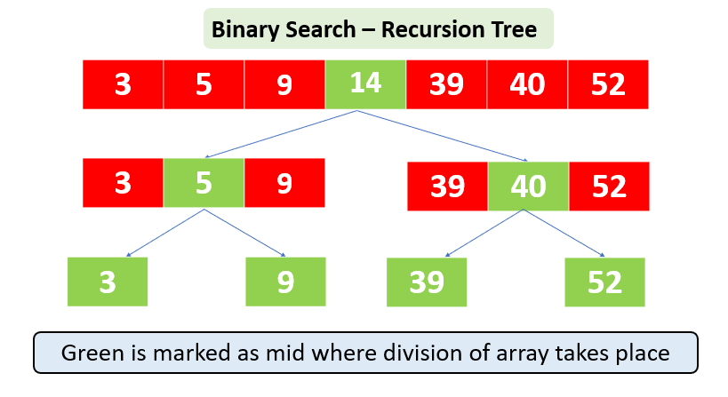

Slide 13
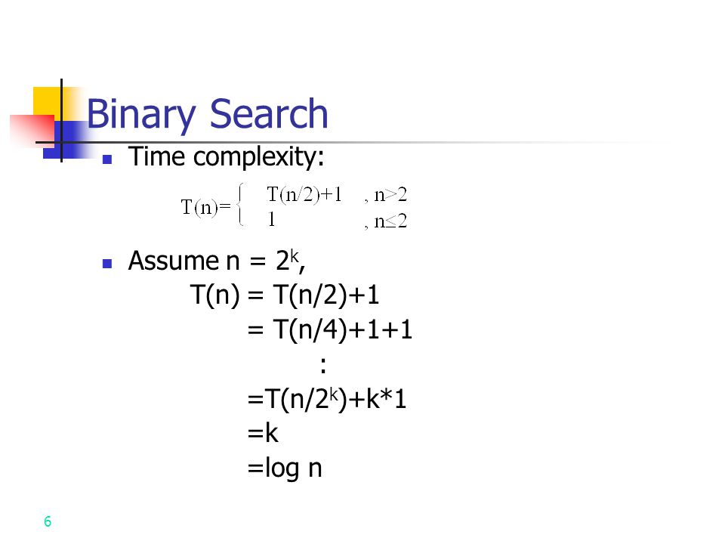

Slide 14
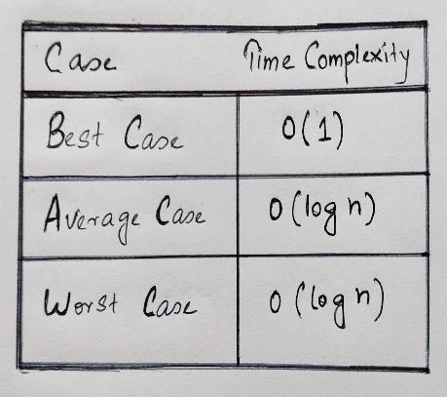

Slide 15
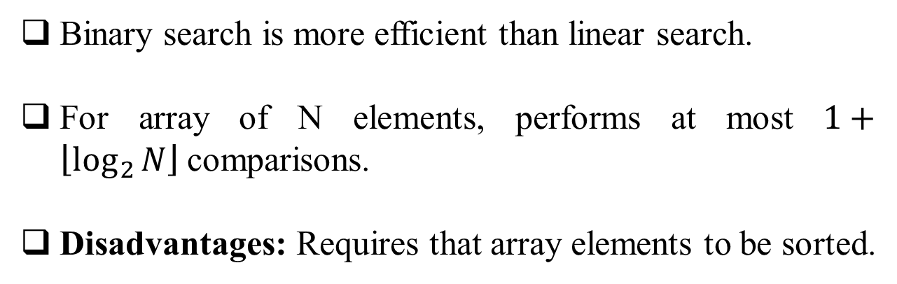
Search
Analysis
Binary search is more efficient than linear search.
For array of N elements, performs at most $1+\left\lfloor \log_{2}{N}\right\rfloor$comparisons.
Disadvantages: Requires that array elements to be sorted.

Slide 16
References
https://en.wikipedia.org/wiki/Insertion_sort
https://en.wikipedia.org/wiki/Sorting_algorithm
Nice animations are available here https://www.cs.usfca.edu/~galles/visualization/ComparisonSort.html
https://en.wikipedia.org/wiki/Linear_search
https://en.wikipedia.org/wiki/Binary_search_algorithm

Slide 17
Books
“Schaum's Outline of Data Structures with C++”. By John R. Hubbard
“Data Structures and Program Design”, Robert L. Kruse, 3rd Edition, 1996.
“Data structures, algorithms and performance”, D. Wood, Addison-Wesley, 1993
“Advanced Data Structures”, Peter Brass, Cambridge University Press, 2008
“Data Structures and Algorithm Analysis”, Edition 3.2 (C++ Version), Clifford A. Shaffer, Virginia Tech, Blacksburg, VA 24061 January 2, 2012
“C++ Data Structures”, Nell Dale and David Teague, Jones and Bartlett Publishers, 2001.
“Data Structures and Algorithms with Object-Oriented Design Patterns in C++”, Bruno R. Preiss,

